Slide 1
Capstone 2 - Image Classification of Poison Ivy Using CNN
By: Jeff Baksa

Slide 2

Motivation
Broad scale:
Natural resource managers must understand what they manage
Plants support many enterprises:
Wildlife management
Animal producer
Know how to manipulate plants (ie: keep or remove)
Poison ivy specifically:
Everyone says lookout for shiny leaves of 3
From my own experience, the plant is really hard to spot

Slide 3
Data Sources
Approximately 2050 total images...
Cleaned, precise pictures provided by https://github.com/bazilione/poison_ivy
220 poison ivy
220 raspberry
Webscraped ~1600 images from Google Images using Chrome Driver
Wanted to add some complexity to the clean dataset above for realism
Manually double checked them to ensure they’re reasonable
Four other types of Non-Poison Ivy plants used:
Virginia Creeper
Box Elder
Boston Ivy
Skunkbush

Slide 4
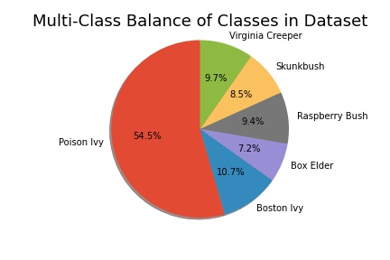
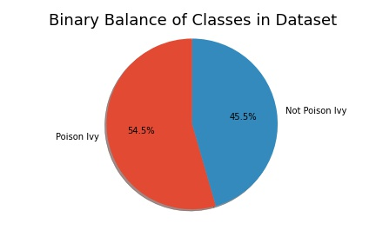
Dataset Class Balance

Slide 5
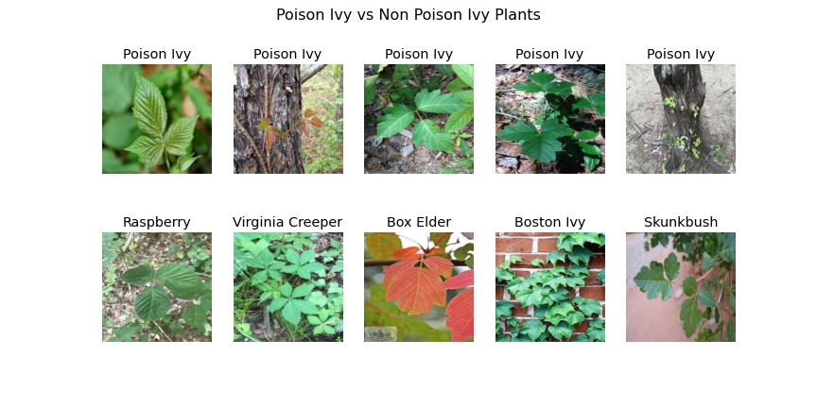
Example Images From Dataset
Intentionally selected plants commonly mistaken for poison ivy
Poison ivy comes in a variety of shapes and sizes

Slide 6

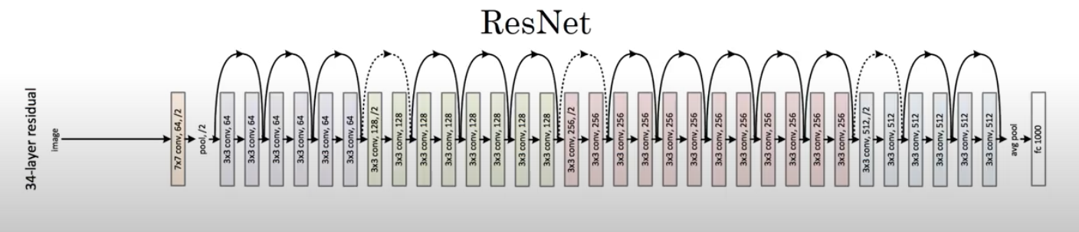
Tested 3 Different Models
Baseline
VGG16
ResNet34
Baseline - 2 layers deep
Used pretrained weights of VGG16 and ResNet34
Changed output layers to classify images of the plants

Slide 7
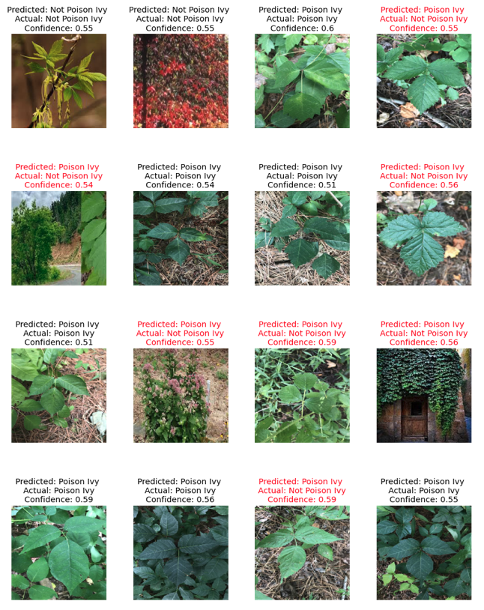
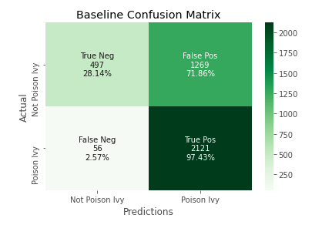
Baseline Model
Two layers deep with MaxPooling
Predicted almost every image as PI

Slide 8
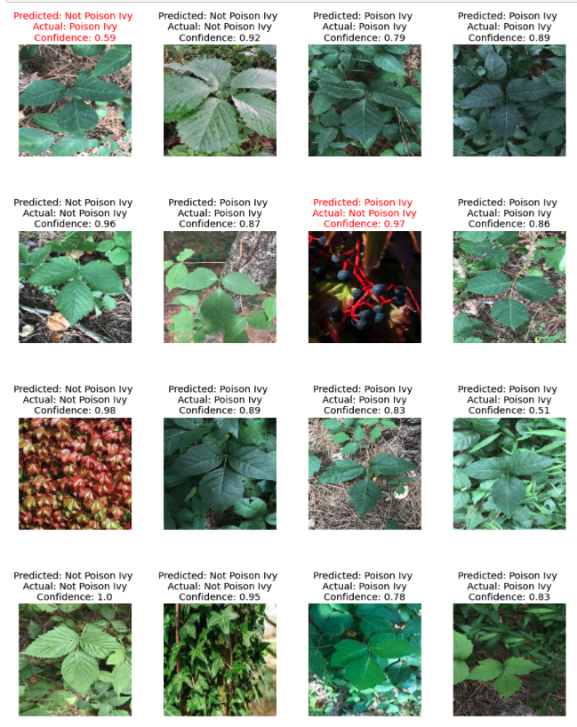
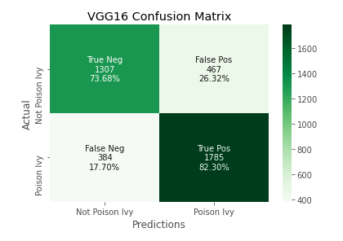
VGG16 Model
Clearly improved from baseline

Slide 9
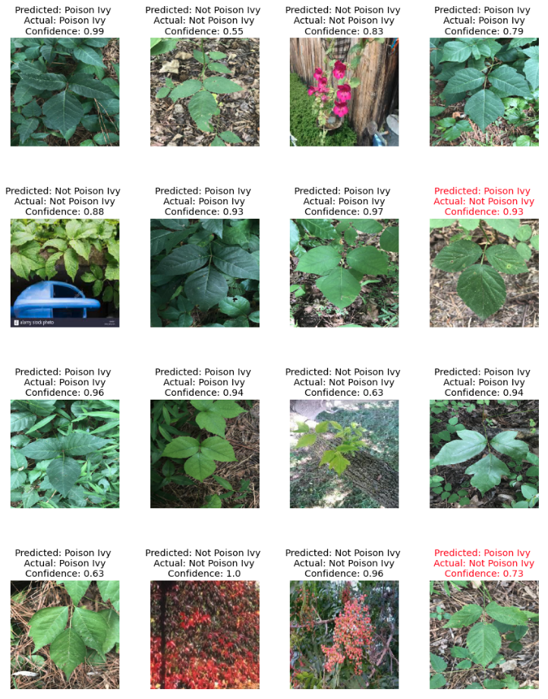
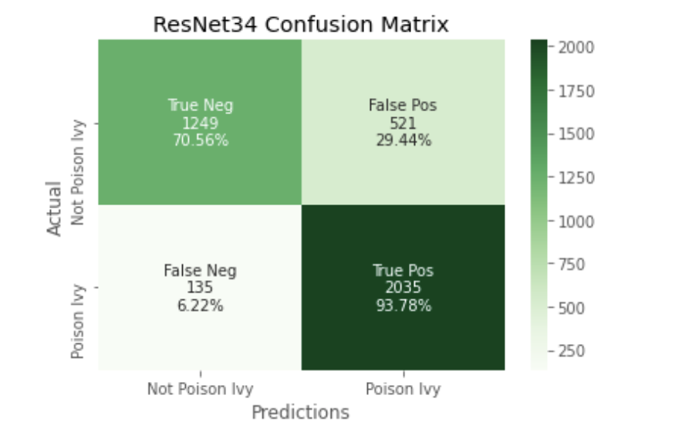
ResNet34 Model
Minimized false negatives very well

Slide 10
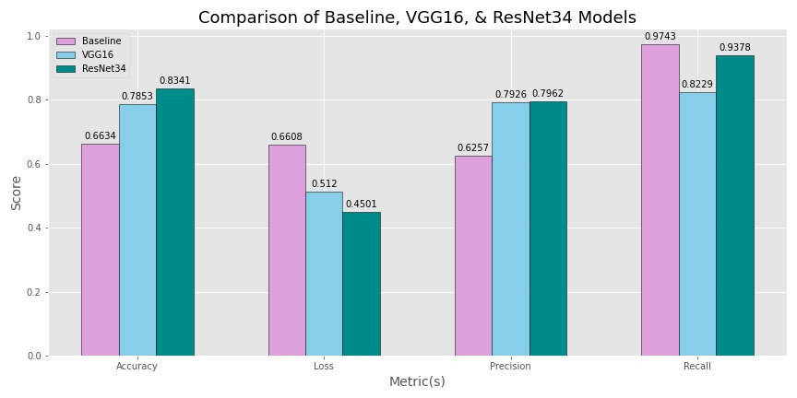
Recap: Model Comparison

Slide 11
Future Steps
Continued adjustments to model’s hyperparameters
Train models further from their best checkpoint
Multi-classification
Specific type of plant rather than “not poison ivy”
Get a fourth model working (Xception)

Slide 12
Technologies & Dataset Used
Technologies
Python
Numpy
Matplotlib
Seaborn
OS
TensorFlow
Keras
SciKitLearn
SciKitImage
Google Colab
Datasets
https://github.com/bazilione/poison_ivy

